Slide 1


Distributed Traffic Analysis and Visualization Platform on K8s
Group_X 2024.07.19

Slide 2

Group Member
Bao Han
Zhang Xinyu
Sichuan University, School of Cyber Science and Engineering
Sichuan University, School of Cyber Science and Engineering
Wang Qianxu
Han Yiniu
Sichuan University, College of Software Engineering
Chongqing University, School of Big Data and Software Engineering

Slide 3


CONTENTS
PART 1
Background
PART 2
General View
PART 3
Web app
PART 4
K8s arch

Slide 4

PART 1 Background

Slide 5
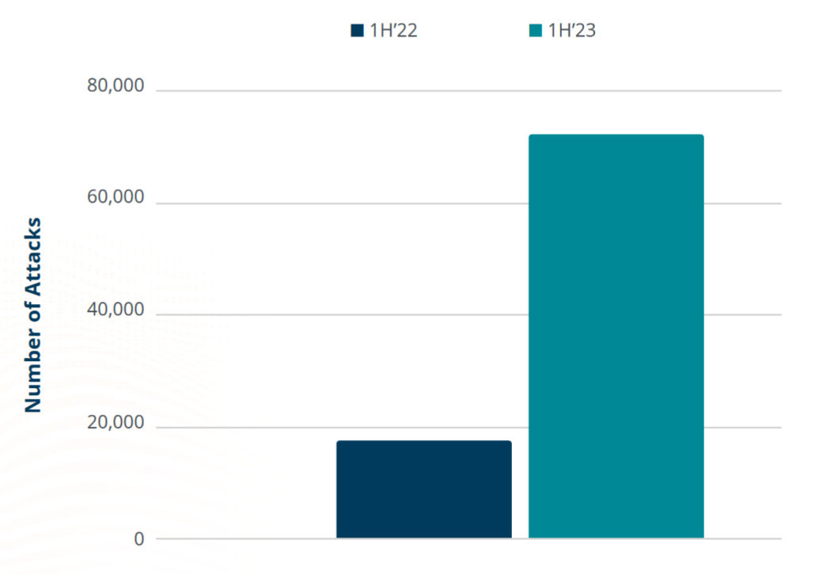
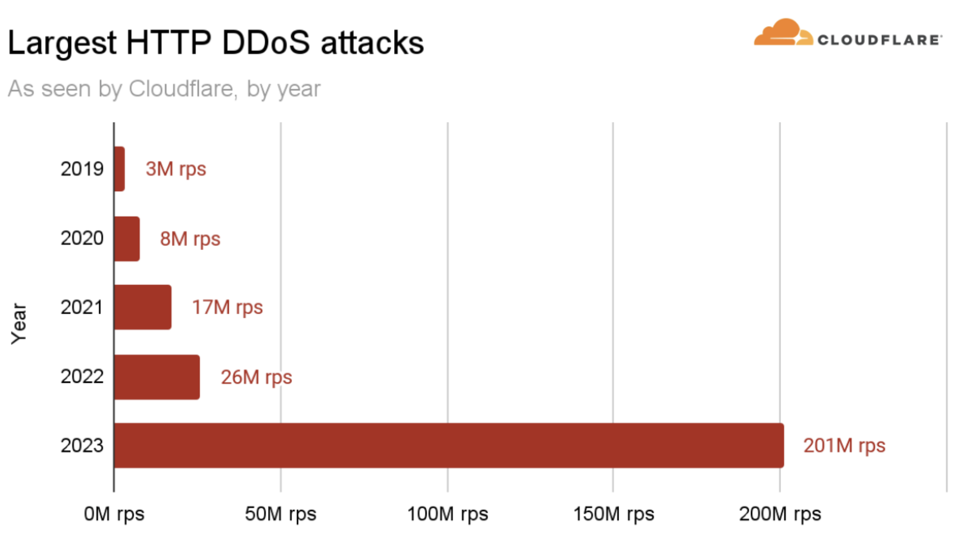
PART 1 Background
CyberSecurity
Fig1: The total number of DDos attacks in the first half of 2022 VS the first half of 2023
Fig2: Largest HTTP DDoS attacks observed by Cloudflare from 2019 to 2023
Notes:
Take DDos attacks for example
The frequency of DDoS attacks across all industries increased by 314%.
2023 is the year of uncharted territory. DDoS attacks have reached new heights of scale and sophistication.

Slide 6
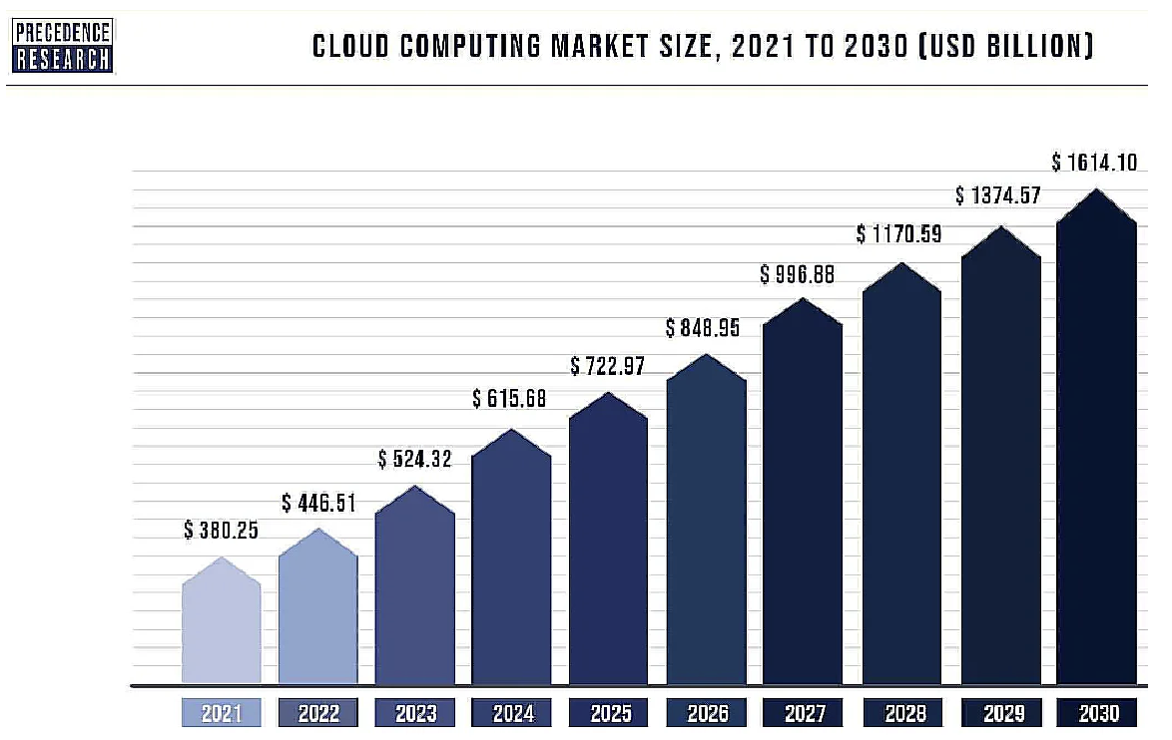
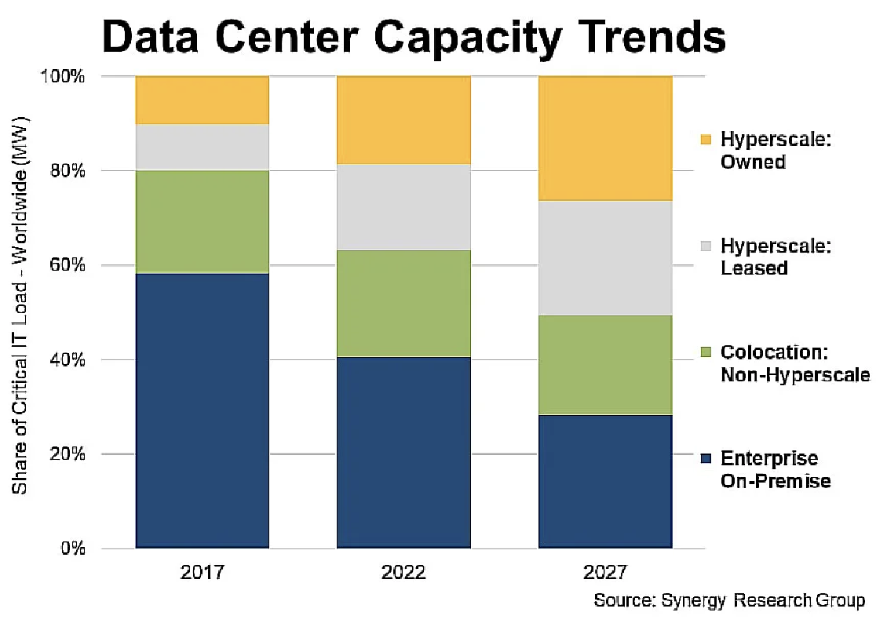
PART 1 Background
Cloud Computing
Fig3: Cloud computing market forecast
Fig4: The cloud dominates workload processing (Source: Cisco)
Notes:
The global cloud computing market size is valued at over $500 billion in 2023，Globally, the cloud computing market will surpass $1 trillion by 2028 and $1.6 trillion by 2030. The global cloud computing market grew to $446.51 billion in 2022.

Slide 7
PART 1 Background
Why Pcap ？
Advantages:
Low-level data capture
Cross-platform support
Extensive protocol support
Powerful filtering capabilities
Rich ecosystem
Notes:
The global cloud computing market size is valued at over $500 billion in 2023，Globally, the cloud computing market will surpass $1 trillion by 2028 and $1.6 trillion by 2030. The global cloud computing market grew to $446.51 billion in 2022.

Slide 8
PART 2 General View

Slide 9
PART 2 General View
Requirements and structure
Requirements:
Network Protocol Analysis and Visualization
Extract various network protocol data from pcap files.
Analyze traffic distribution across different protocol types
Visualize traffic data for each protocol type
Malicious Traffic Detection and Tracking
Detect potential malicious traffic within the network traffic
Track and analyze the source IP and addresses of the malicious traffic
Notes:
The global cloud computing market size is valued at over $500 billion in 2023，Globally, the cloud computing market will surpass $1 trillion by 2028 and $1.6 trillion by 2030. The global cloud computing market grew to $446.51 billion in 2022.

Slide 10
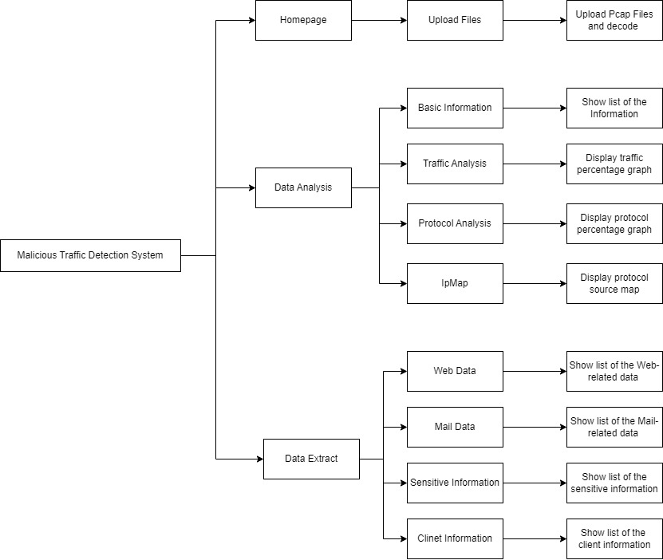
PART 2 General View
Function Model
Notes:
The global cloud computing market size is valued at over $500 billion in 2023，Globally, the cloud computing market will surpass $1 trillion by 2028 and $1.6 trillion by 2030. The global cloud computing market grew to $446.51 billion in 2022.

Slide 11
PART 3 Web app

Slide 12
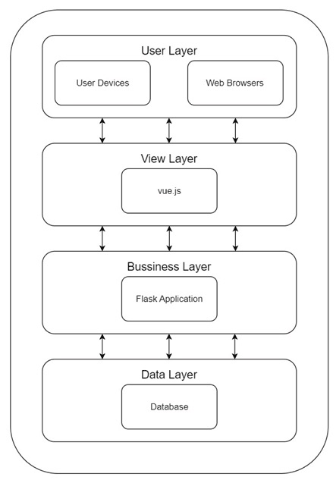
PART 3 Web App
Architecture
Users use the web browser to access the URL of the application.
The front-end is implemented using the Vue.js framework,
which is responsible for presenting the user interface,
processing user interactions,
sending data requests,
displaying the data and analysis results returned by the back-end.
Notes:
The global cloud computing market size is valued at over $500 billion in 2023，Globally, the cloud computing market will surpass $1 trillion by 2028 and $1.6 trillion by 2030. The global cloud computing market grew to $446.51 billion in 2022.

Slide 13
PART 3 Web app
Business Layer
Upload
Detection
Upload the pcap file and process it in json format
Check whether the traffic contains malicious traffic and the type of malicious traffic
We’re No.1
File Analysis
Provide visual representations of network traffic, including graphs and charts, to highlight trends and anomalies.

Slide 14
PART 4 k8s Architecture

Slide 15
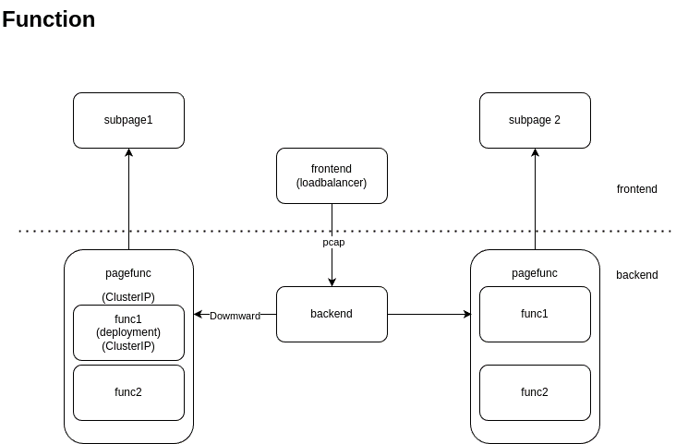
PART 4 k8s Architecture

Slide 16
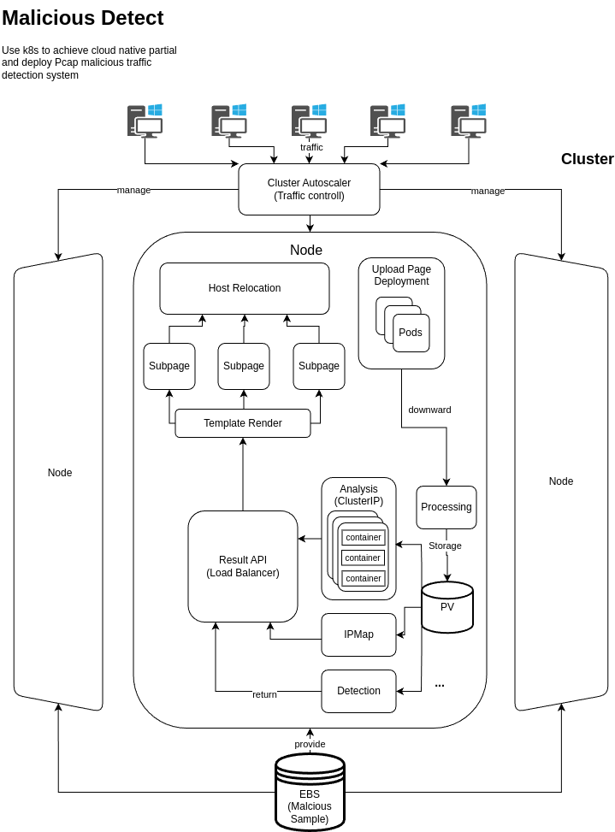
PART 4 k8s Architecture

Slide 17
PART 5
Presentation

Slide 18

Thanks！
Group_X 2024.07.19

